Slide 1

Box Office Reporting
PRESENTED BY…..
KOMAL JADHAV
TEJASHWINI
PRIYANKA
T SONY

Slide 2
PROBLEM STATEMENT
Box Office Reporting
CURD : Box Office Data Report _Box_Office_Earnings(film_id) :
Report and analyse box office earnings for films.
Compare_earnings_across_theaters(comparison data) : Comparison
earnings across different theatres

Slide 3
INTRODUCTION
Create Data: Allow users to input box office data, including film ID, theater, and earnings. This operation should append the provided data to the system.
Read Data: Provide the capability to display all existing box office data stored in the system.
Update Data: Enable users to modify box office earnings for a specific film in a given theater.
Delete Data: Allow users to remove box office data for a particular film and theater from the system.
Report Box Office Earnings: Implement a function to report and analyze box office earnings for a specified film. This function should display earnings for each theater where the film is screened.
Comparison Across Theaters: Develop a feature to compare earnings across different theaters for the same film. This comparison should provide insights into the distribution of earnings among various theaters.

Slide 4
REQUIREMENT ANALYSIS
** Functional Requirements:
CRUD Operations
2. Reporting and Analysis:
** Non-Functional Requirements
3. Constraints
4. Assumptions
5. Future Enhancements:

Slide 5
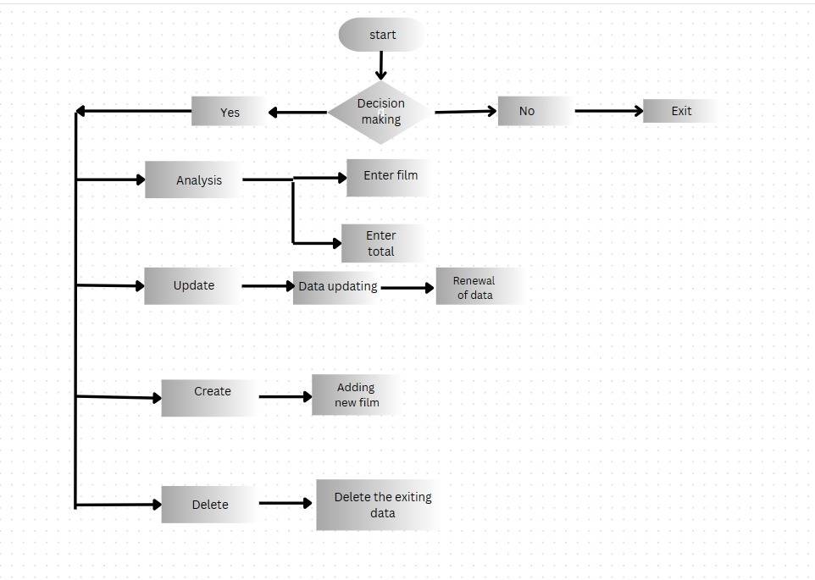
FLOWCHART

Slide 6
Functions
# AbstractBox_office.py from abc import ABC, abstractmethod class AbstractBox_office(ABC): @abstractmethod def create_items(self, film_id, theater_id, earnings): pass @abstractmethod def read_items(self, film_id=None, theater_id=None): pass @abstractmethod def update_items(self, film_id, theater_id, new_earnings): pass @abstractmethod def delete_items(self, film_id, theater_id): pass

Slide 7
# box_office.py from AbstractBox_office import AbstractBox_office class Box_office(AbstractBox_office): def __init__(self): self.data = [] def create_items(self, film_id, theater_id, earnings): self.data.append({'film_id': film_id, 'theater_id': theater_id, 'earnings': earnings}) def read_items(self, film_id=None, theater_id=None): if film_id: return [items for items in self.data if items['film_id'] == film_id] elif theater_id: return [items for items in self.data if items['theater_id'] == theater_id] else: return self.data def update_items(self, film_id, theater_id, new_earnings): for items in self.data: if items['film_id'] == film_id and items['theater_id'] == theater_id: items['earnings'] = new_earnings def delete_items(self, film_id, theater_id): self.data = [items for items in self.data if not (items['film_id'] == film_id and items['theater_id'] == theater_id)]

Slide 8
# Main.py from box_office import Box_office class BoxOfficeAnalyzer: def __init__(self, box_office_data): self.box_office_data = box_office_data def report_box_office_earnings(self, film_id): try: film_entries = self.box_office_data.read_items(film_id=film_id) total_earnings = sum(entry['earnings'] for entry in film_entries) average_earnings = total_earnings / len(film_entries) max_earning_items = max(film_entries, key=lambda x: x['earnings']) print("Report for Film ID:", film_id) print("Total Earnings:", total_earnings) print("Average Earnings per Theater:", average_earnings) print("Theater with Highest Earnings:", max_earning_items['theater_id']) except Exception as e: print("Error:", e) def compare_earnings_across_theaters(self, comparison_data): earnings_comparison = {} for theater_id in comparison_data: try: theater_entries = self.box_office_data.read_items(theater_id=theater_id) total_earnings = sum(entry['earnings'] for entry in theater_entries) earnings_comparison[theater_id] = total_earnings except Exception as e: print("Error while comparing theater", theater_id, ":", e) print("Comparison of Earnings Across Theaters:", earnings_comparison)

Slide 9
def create_item(self, film_id, theater_id, earnings): try: self.box_office_data.create_items(film_id, theater_id, earnings) print("Item created successfully.") self.show_box_office() except Exception as e: print("Error:", e) def update_item(self, film_id, theater_id, new_earnings): try: # Convert new_earnings to float new_earnings = float(new_earnings) self.box_office_data.update_items(film_id, theater_id, new_earnings) print("Item updated successfully.") self.show_box_office() except Exception as e: print("Error:", e) def delete_item(self, film_id, theater_id): try: self.box_office_data.delete_items(film_id, theater_id) print("Item deleted successfully.") self.show_box_office() except Exception as e: print("Error:", e) def show_box_office(self): all_entries = self.box_office_data.read_items() print("\nThe current data of box-office is:\n") for entry in all_entries: print("Film ID:", entry['film_id']) print("Theater ID:", entry['theater_id']) print("Earnings:", entry['earnings']) print()

Slide 10
if __name__== "__main__": box_office = Box_office() box_office.create_items('film1', 'theater1', 1000) box_office.create_items('film2', 'theater1', 1500) box_office.create_items('film1', 'theater1', 1000) box_office.create_items('film2', 'theater1', 1500) box_office.create_items('film3', 'theater1', 1200) box_office.create_items('film4', 'theater1', 2550) box_office.create_items('film5', 'theater1', 1800) box_office.create_items('film1', 'theater2', 2500) box_office.create_items('film2', 'theater2', 1800) box_office.create_items('film3', 'theater2', 1800) box_office.create_items('film4', 'theater2', 1880) box_office.create_items('film5', 'theater2', 1800) box_office.create_items('film1', 'theater3', 1500) box_office.create_items('film2', 'theater3', 1800) box_office.create_items('film3', 'theater3', 1800) box_office.create_items('film4', 'theater3', 1600) box_office.create_items('film5', 'theater3', 1807) box_office.create_items('film1', 'theater4', 2200) box_office.create_items('film2', 'theater4', 1800) box_office.create_items('film3', 'theater4', 1800) box_office.create_items('film4', 'theater4', 1850) box_office.create_items('film5', 'theater4', 1800) box_office.create_items('film1', 'theater5', 2800) box_office.create_items('film2', 'theater5', 1700) box_office.create_items('film3', 'theater5', 2800) box_office.create_items('film4', 'theater5', 2800) box_office.create_items('film5', 'theater5', 3500) print("Welcome to Box Office Report!") analyzer = BoxOfficeAnalyzer(box_office)

Slide 11
while True: print("\nHow may I help you?") help_input = int(input("Enter your request ('analysis(1)', 'create(2)', 'update(3)', 'delete(4)', 'exit(5)'): ")) if help_input== 1: print("What analysis would you like to perform?") analysis_type = input("Enter 'film' for film earnings or 'total' for total earnings: ") if analysis_type.lower() == "film": film_id = input("Enter the film ID: ") analyzer.report_box_office_earnings(film_id) elif analysis_type.lower() == "total": analyzer.compare_earnings_across_theaters(['theater1', 'theater2', 'theater3', 'theater4', 'theater5']) else: print("Sorry, we don't have information about that.") elif help_input == 2: film_id = input("Enter the film ID: ") theater_id = input("Enter the theater ID: ") earnings = float(input("Enter the earnings: ")) analyzer.create_item(film_id, theater_id, earnings) elif help_input == 3: film_id = input("Enter the film ID: ") theater_id = input("Enter the theater ID: ") new_earnings = input("Enter the new earnings: ") analyzer.update_item(film_id, theater_id, new_earnings) elif help_input == 4: film_id = input("Enter the film ID: ") theater_id = input("Enter the theater ID: ") try: analyzer.delete_item(film_id, theater_id) except Exception as e: print("Data not found.") elif help_input == 5: print("Exiting...") breakAA

Slide 12
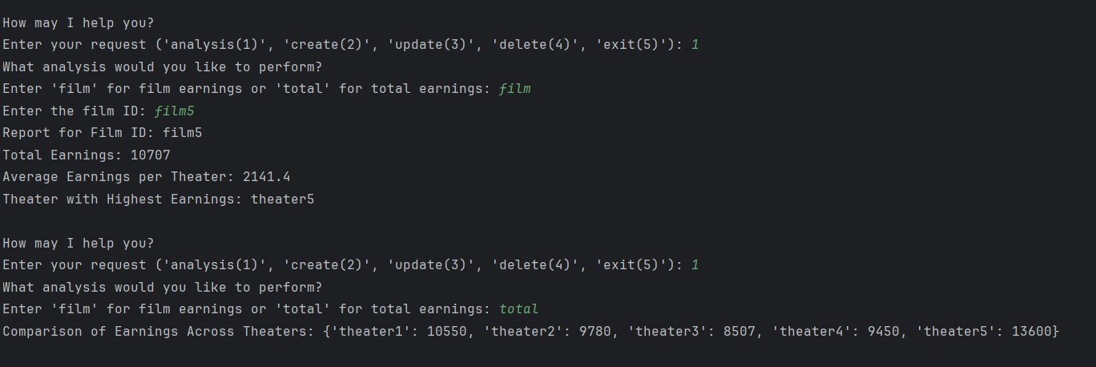
Output 1 :

Slide 13
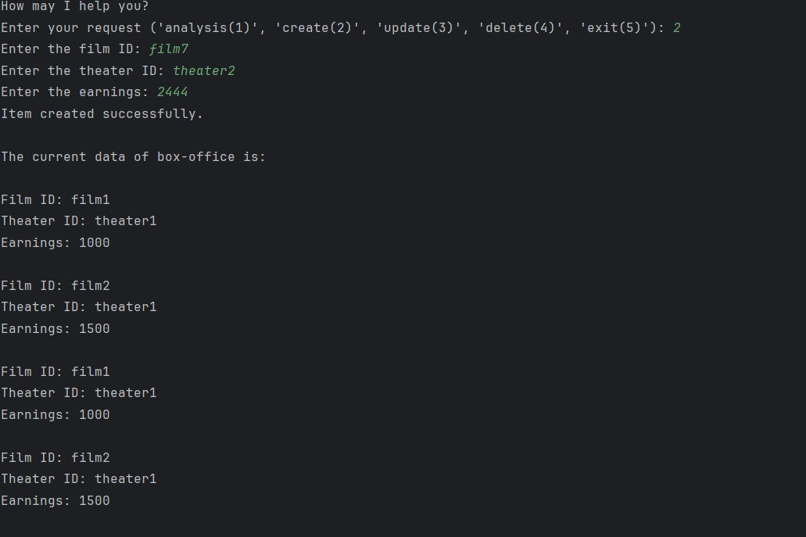
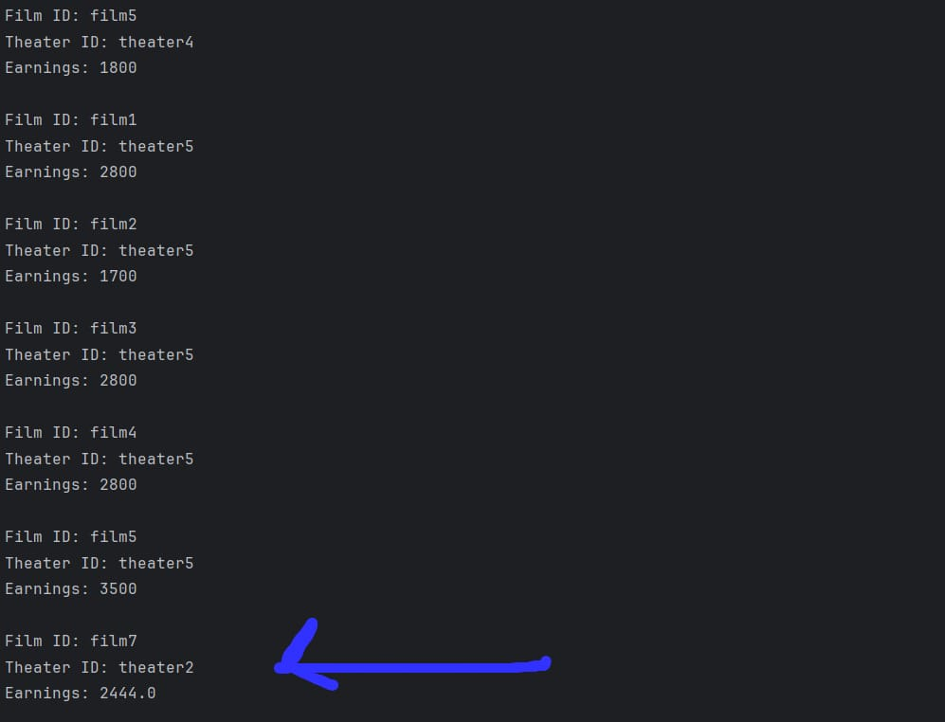
Output 2

Slide 14
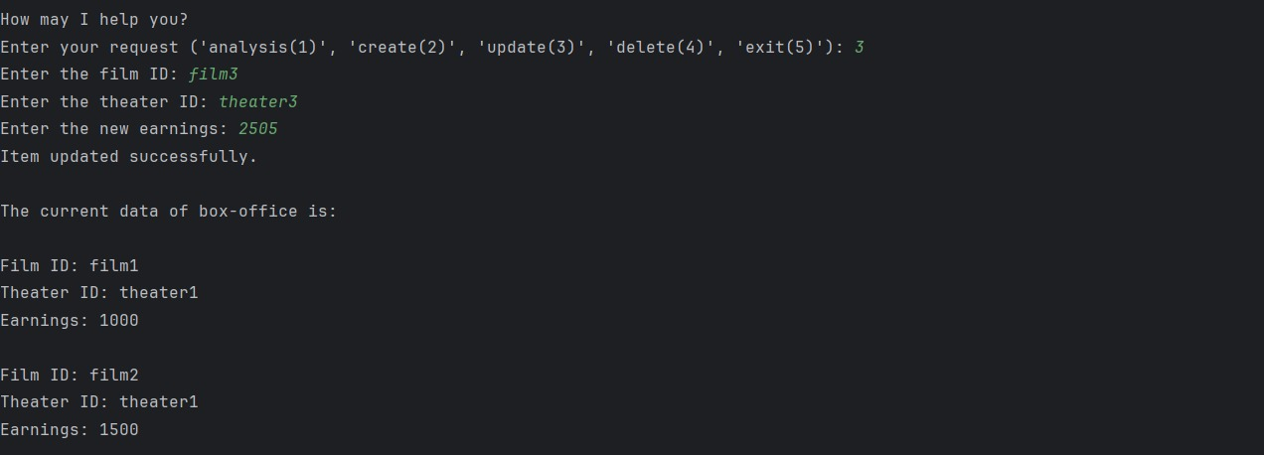
Output 3:

Slide 15
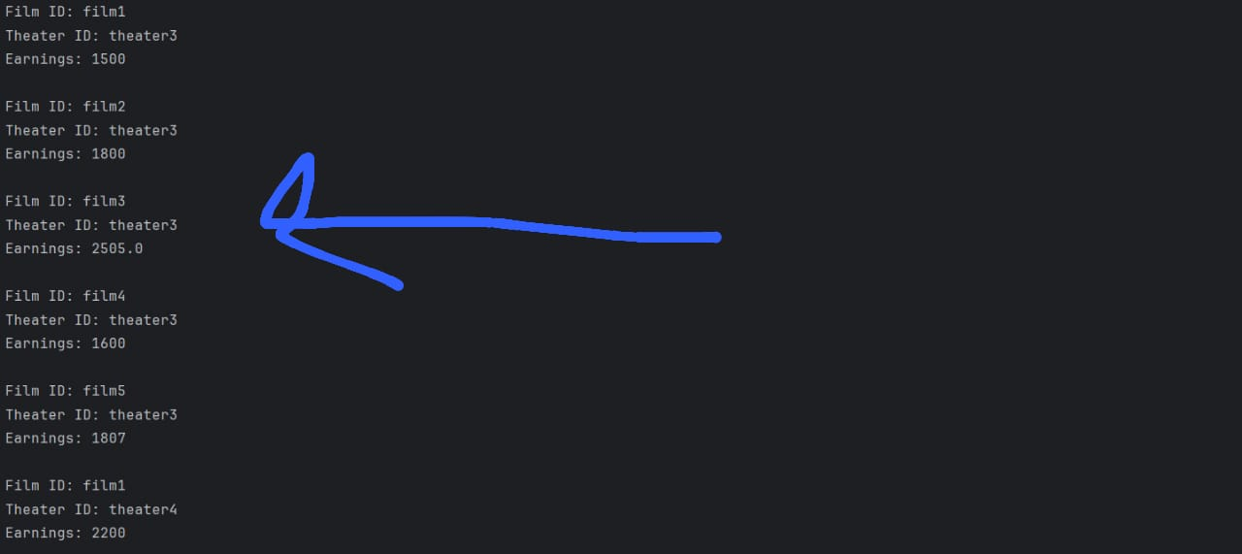

Slide 16
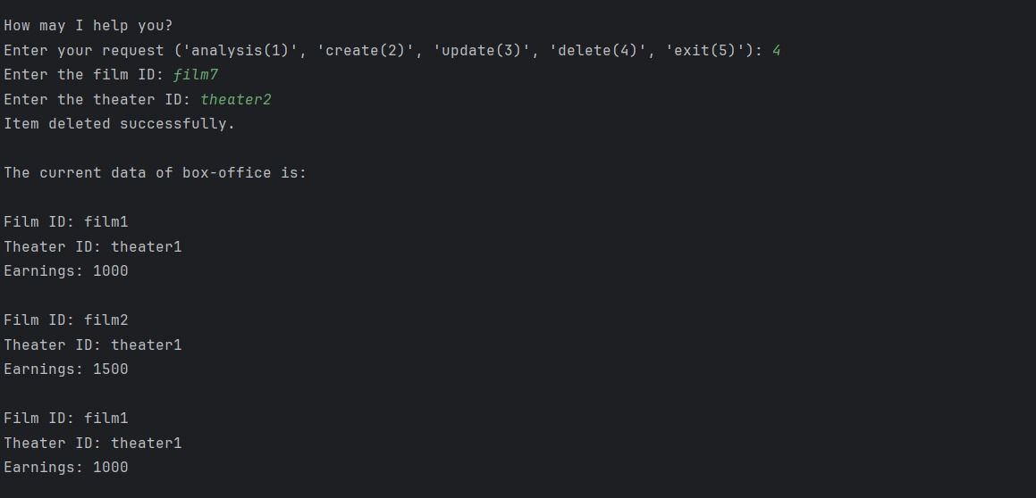
Output 4:

Slide 17
Output 5:

Slide 18


